Slide 1
LE LINEE GUIDA ASMBS/IFSO
Antonio Vitiello M.D. PhD FIFSO
Ricercatore in Chirurgia Generale
AOU Federico II di Napoli
Dirigente Medico- UOC Chirurgia Generale Oncologica e Mininvasiva - Direttore Prof. Vincenzo Pilone

Slide 2
A 1978 NIH consensus conference on surgery for obesity considered primarily intestinal (jejunoileal) bypass
The 1978 conference highlighted the undesirable side effects of this operation, and its use has all but disappeared
In a 1985 National Institutes of Health (NIH) consensus conference, the health implications of obesity were established (hypertension, dyslipidemia, diabetes mellitus, gallbladder disease, increased prevalence and mortality ratios of selected types of cancer, and socioeconomic and psychosocial impairment)

Slide 3
What Are the Nonsurgical Treatment Options for Severe Obesity and Their Consequences?
What Are the Surgical Treatments and Criteria for Selection?
What Are the Efficacy and Risks of Surgical Treatments for Obesity?
What Specific Recommendations Can Be Made for the Treatment of Severe Obesity?
What Are the Future Directions for Basic Science, Clinical Research, and Epidemiological Evaluation of Therapy?

Slide 4
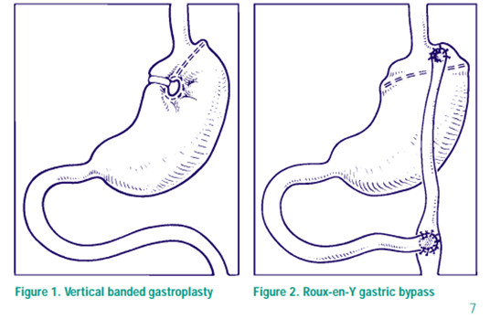
What Are the Efficacy and Risks of Surgical Treatments for Obesity?

Slide 5
Patients whose BMI exceeds 40
In certain instances less severely obese patients (with BMI’s between 35 and 40)
Children and adolescents have not been sufficiently studied
patients should first be considered for treatment in a nonsurgical program

Slide 6
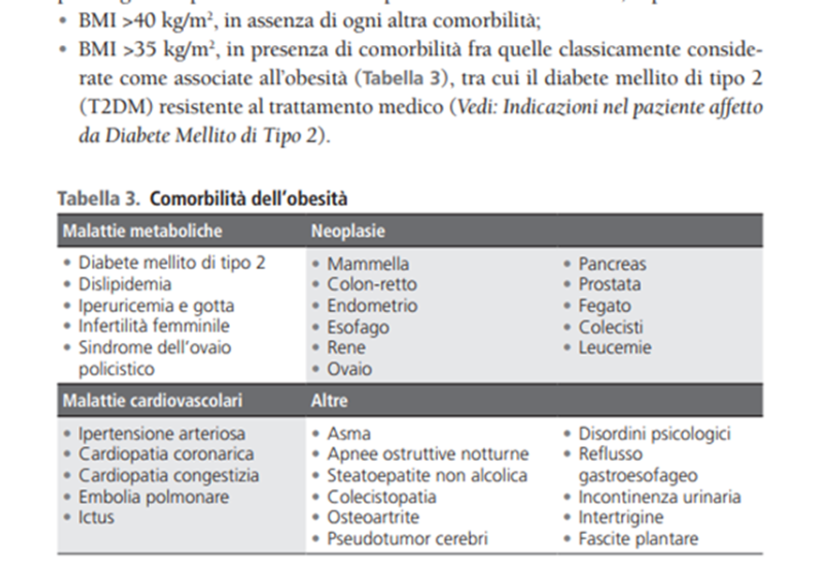

Slide 7
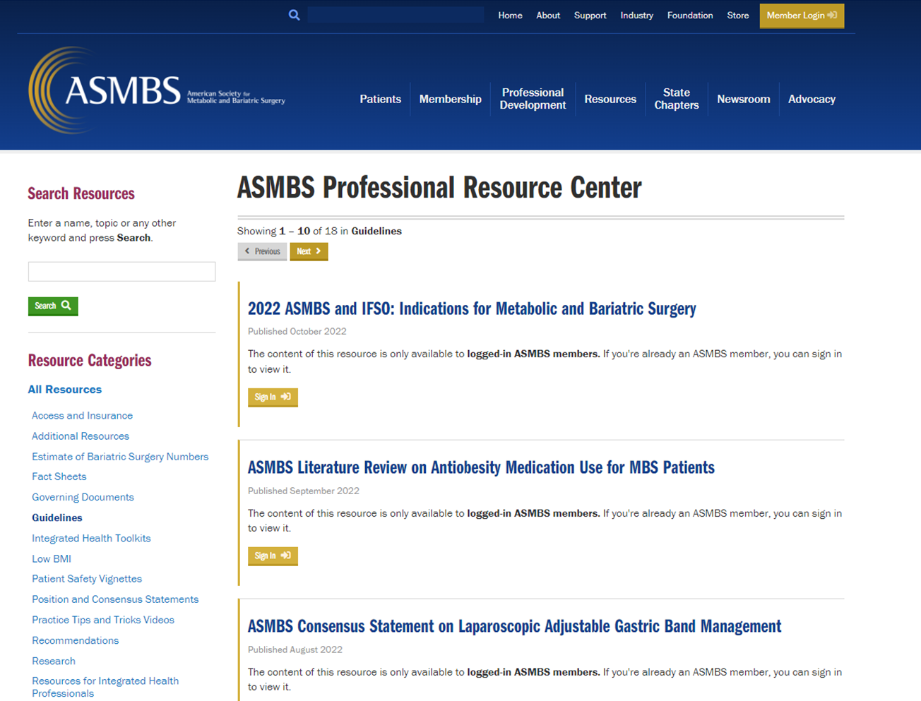
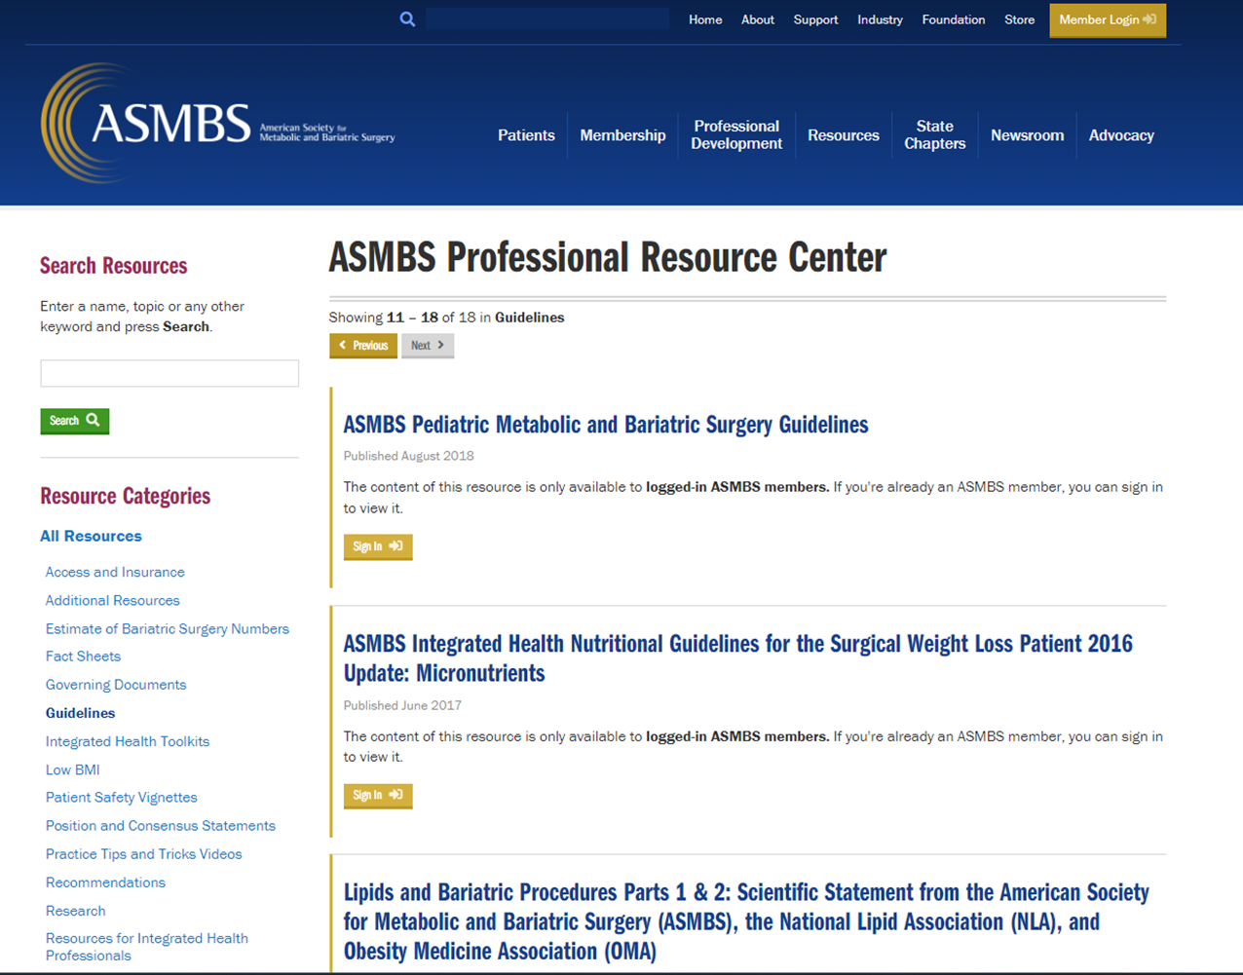

Slide 8
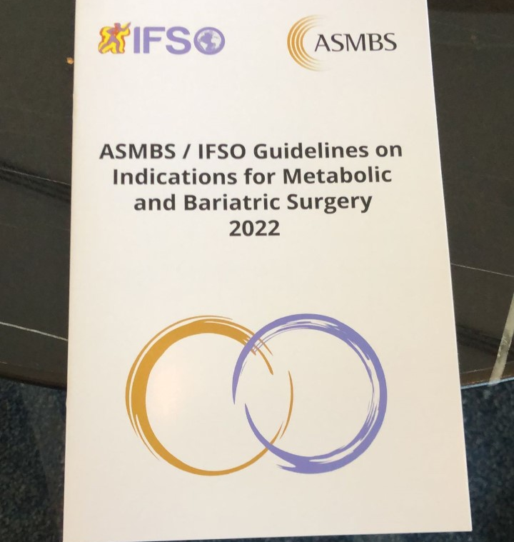

Slide 9
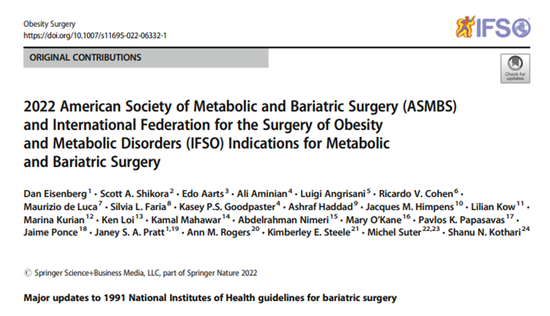
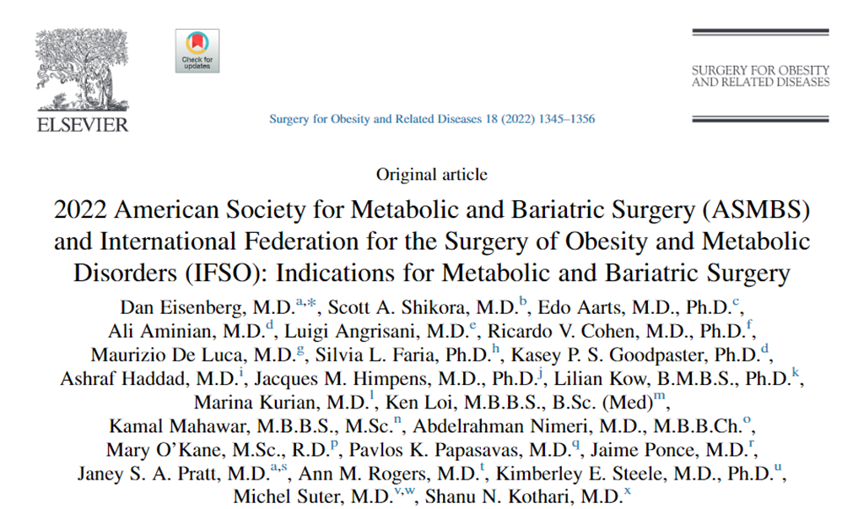

Slide 10
MBS is recommended for individuals with BMI >35 kg/m²,regardless of presence, absence, or severity of comorbidities.
MBS is recommended in patients with T2D and BMI >30 kg/m²
MBS should be considered in individuals with BMI of 30–34.9 kg/m² who do not achieve substantial or durable weight loss or co-morbidity improvement using nonsurgical methods.

Slide 11
Clinical obesity in the Asian population is recognized in individuals with BMI >25 kg/m²
Children and adolescents with BMI >120% of the 95th percentile and a major co-morbidity, or a BMI >140% of the 95th percentile, should be considered for MBS after evaluation by a multidisciplinary team in a specialty center

Slide 12
There is no evidence to support an age limit on patients seeking MBS, but careful selection that includes assessment of frailty is recommended
Studies failed to demonstrate a significant difference in perioperative complications, length of Obesity Surgery stay, 30-day mortality, or long-term outcomes after MBS when individuals with BMI >60 kg/m² were compared with those with BMI <60 kg/m²
Furthermore, studies have shown that MBS can be performed safely in patients with BMI >70 kg/m²

Slide 13
There are reports to suggest that MBS may be effective as a bridge to total joint arthroplasty in individuals with class II/III obesity when performed >2 years prior to joint surgery
In patients with severe obesity and an abdominal wall hernia requiring elective repair, MBS should be considered first to induce significant weight loss
MBS is associated with an 88% risk reduction of progression of NASH to cirrhosis
Patients with endstage organ disease can achieve meaningful weight loss and improve their eligibility to receive an organ transplant

Slide 14
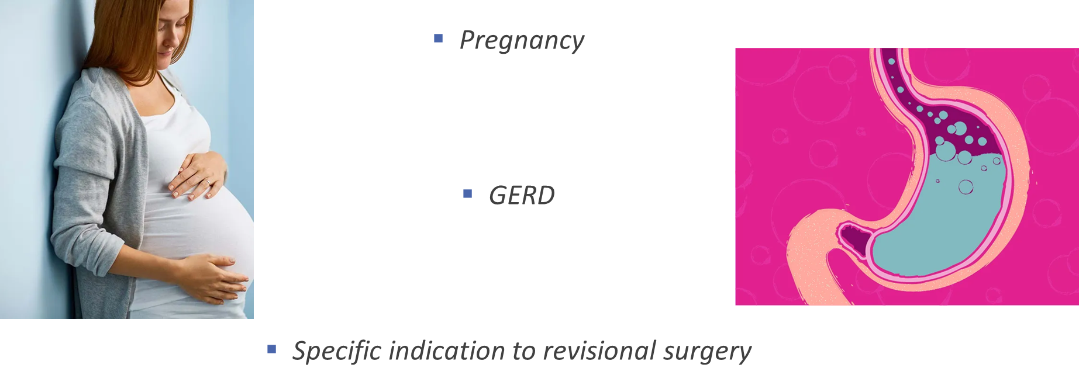
LACK OF SUPPORTING EVIDENCE…..

Slide 15
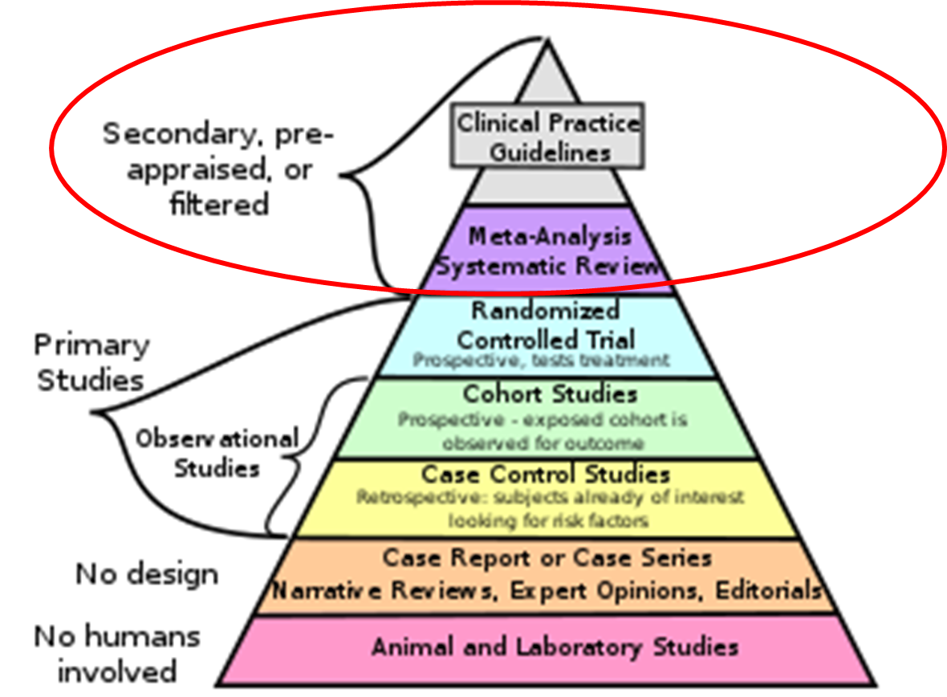

Slide 17
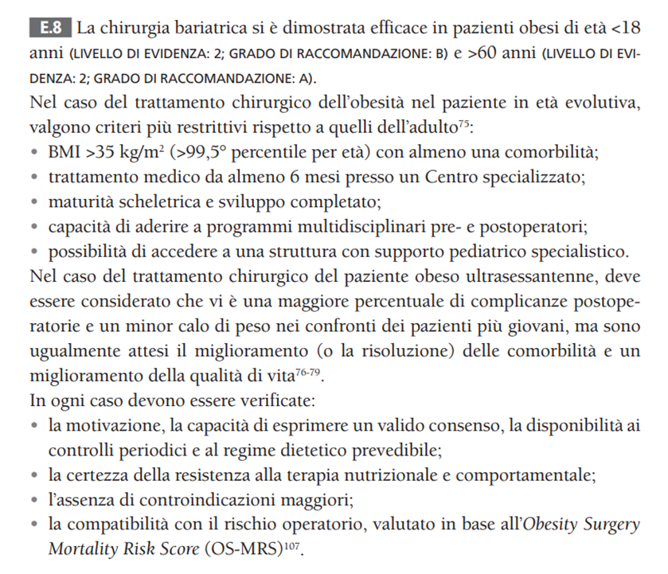
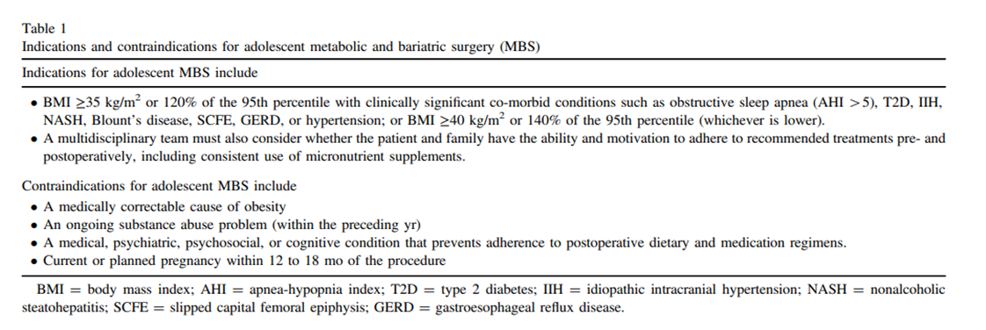

Slide 18
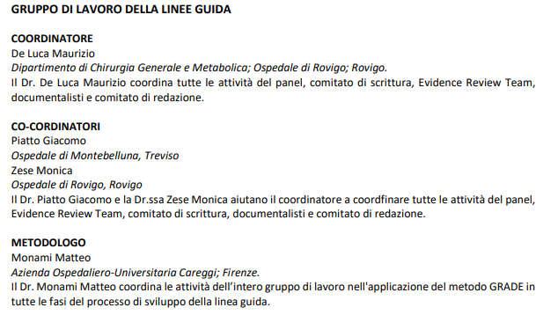
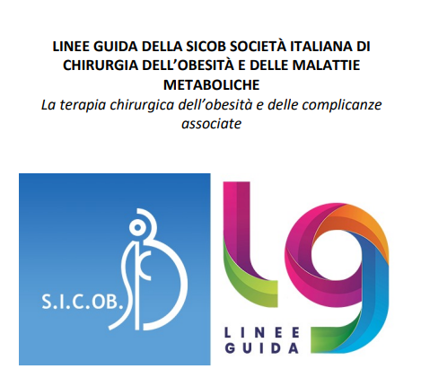
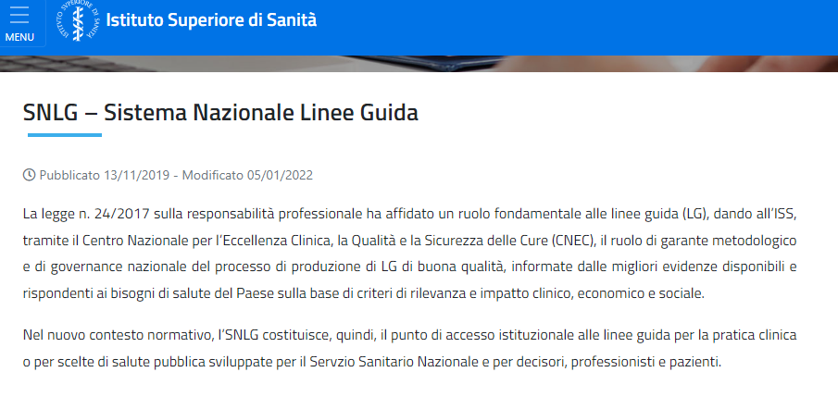

Slide 19
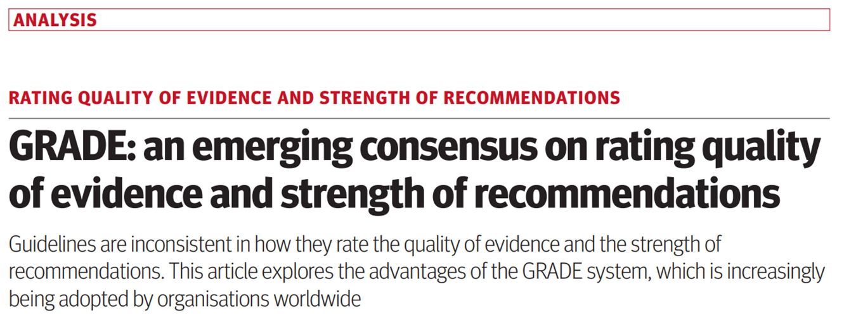
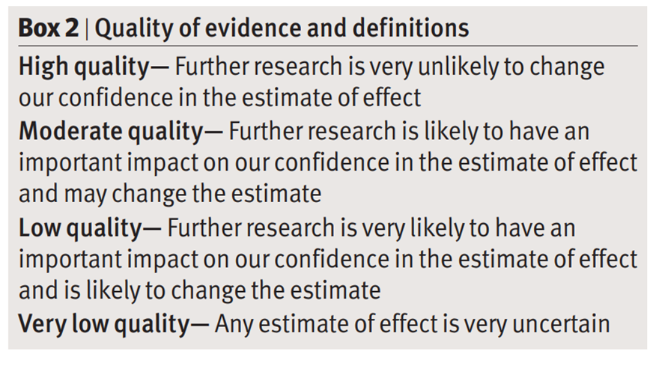

Slide 21
Methods
In order to methodologically support the previously published ASMBS/IFSO guidelines, two international teams of writers were created.
One team of seven researcher (MDL, GM, AI, GP, ST, SC, AV) performed a systematic search of high-level evidence for different items, according to the PRISMA

Slide 22
Methods
Two independent researchers for every item analyzed each article
In case of disagreement a third researcher (MDL) was consulted.

Slide 23
Methods
First Name | Last Name | Country
Edo | Aaarts | Netherland
Ahmad | Aly | Australia
Ali | Aminian | USA
Luigi | Angrisani | Italy
Ahmad Abdallah | Bashir | Jordan
Estuardo | Behrens | Guatemala
Helmuth Thorlakur | Billy | USA
Sonja | Chiappetta | Italy
Jean Marc | Chevallier | France
Ricardo Vitor | Cohen | Brazil
Maurizio | De Luca | Italy
Pierre Y | Garneau | Canada
Khaled Aly | Gawdat | Egypt
Ashraf | Haddad | Jordan
Jacques M | Himpens | Belgium
Farah Anwari | Husain | USA
Angelo | Iossa | Italy
Mohammad | Kermansaravi | Iran
Shanu Nikhil | Kothari | USA
Lilian | Kow | Australia
Marina | Kurian | USA
Teresa LeAnn | LaMasters | USA
Silvia | Leite Faria | Brazil
Ken Wing King | Loi | Australia
Kamal K | Mahawar | UK
Corrigan Lee | McBride | USA
Giovanni | Merola | Italy
Monali | Misra | USA
Abdelrahman Ali | Nimeri | USA
Joe | Northup | USA
Mary | O’Kane | UK
Pavlos | Papasavas | USA
Richard M | Peterson | USA
Giacomo | Piatto | Italy
Luis | Poggi | Peru
Jaime | Ponce | USA
Gerhard | Prager | Austria
Janey Sue Andrews | Pratt | USA
Almino Cardoso | Ramos | Brazil
Ann M | Rogers | USA
Paulina | Salminen | Finland
Nathaniel James | Sann | USA
John David | Scott | USA
Scott Alan | Shikora | USA
Michel | Suter | Switzerland
Salvatore | Tolone | Italy
Antonio | Vitiello | Italy
Cunchuan | Wang | China
The second team (MDL, MK, ST) was tasked to resolve any issues that were not answered by the systematic reviews.
For these situations, a Delphi survey was constructed and consisted of two consecutive rounds.
Forty-nine recognized MBS experts from 18 different countries participated in this Delphi survey

Slide 24
Methods
Consensus was reached when the agreement/disagreement rate was equal to or greater than 70%.
An online platform (Survey Monkey) was used.
Seven statements reached consensus in the first round and two statements reached consensus in the second round of voting

Slide 25
Level of evidence and grade recommendation
Grade of Recommendation | Level of Evidence | Type of Study
A | 1a | Systematic review of [homogeneous] randomized controlled trials
A | 1b | Individual randomized controlled trials [with narrow confidence intervals]
B | 2a | Systematic review of [homogeneous] cohort studies of "exposed" and "unexposed" subjects
B | 2b | Individual cohort study / low-quality randomized control studies
B | 3a | Systematic review of [homogeneous] case-control studies
B | 3b | Individual case-control studies
C | 4 | Case series, low-quality cohort or case-control studies
D | 5 | Expert opinions based on non-systematic reviews of results or mechanistic studies

Slide 26
Methods
Criteria | PRISMA and DELPHI | Level of Evidence | Grade of Recommendation
MBS for BMI 30 - 34.9 kg/m² | PRISMA | 2a | B
MBS for BMI 35-40 kg/m² without obesity-associated comorbidities | PRISMA Insufficient data DELPHI | 5 | D
BMI thresholds in the Asian population | PRISMA | 2a | B
MBS in the lder population | PRISMA | 2a | B
MBS for the pediatric and adolescents | PRISMA | 1b | A
MBS prior to joint Arthroplasty | PRISMA Conflicting data DELPHI | 2b | B
MBS and abdominal wall hernia repair | PRISMA | 2b | B
MBS prior to organ transplantation | PRISMA | 2b | B
MBS for BMI ≥ 60 kg/m² | PRISMA | 2a | B
MBS in patients with liver cirrhosis | PRISMA | 2b | B
MBS in patients with heart failure | PRISMA | 2b | B
Multidisciplinary care | PRISMA | 2c | B
Revisional surgery | PRISMA | 2b | B
12 different systematic reviews from the 13 PRISMA were carried out.
PRISMA on item 2 (BMI 35-40 kg/m2 without obesity-associated medical problems) produced no studies.

Slide 27
1- MBS for BMI 30 - 34.9 kg/m2
43 articles were included in the present review, 29 (69%) were conducted on non-Asian patients and 13 (31%) on Asian patients.
Operative time and length of stay (LOS) appeared comparable to available data in the literature for MBS in BMI ≥ 35 kg/m².

Slide 28
1- MBS for BMI 30 - 34.9 kg/m2
Recommendation:
• MBS is recommended for patients with T2DM and BMI of 30-34.9 kg/m2.
• MBS is recommended for patients with BMI of 30-34.9 kg/m2 and one obesity-associated medical problem.
• MBS should be considered in patients with BMI of 30-34.9 kg/m2 who do not achieve substantial or durable weight loss or co-morbidity improvement using nonsurgical methods.
Level of Evidence 2a
Grade of recommendation B

Slide 29
2- MBS for BMI 35-40 kg/m2 without obesity-associated medical problems
Leaderships of IFSO and ASMBS have convened a Delphi survey
According to the survey results of 49 experts, MBS is indicated in patients with class II obesity, BMI of 35-40 kg/m², with no associated medical problems in all group of ages following comprehensive multi-disciplinary team (MDT) assessment.

Slide 30
2- MBS for BMI 35-40 kg/m2 without obesity-associated medical problems - Delphi Table 2
Recommendation:
• MBS is recommended for patients with BMI ≥ 35 kg/m² regardless of the presence, absence, or severity of co-morbid conditions.
Level of Evidence 5
Grade of recommendation D

Slide 31
3- BMI thresholds in the Asian population
Seven retrospective (54%, 2 multicenter, 54%) and 6 (46%) prospective studies reported the results of MBS on Asian patients population.
All articles have a good/fair quality. The articles investigated the effects of surgery on patients with BMI < 30 kg/m2.

Slide 32
3- BMI thresholds in the Asian population
Recommendation:
• Clinical obesity in the Asian population is recognized in patients with BMI ≥ 25 kg/m².
Level of Evidence 2a
Grade of recommendation B
Access to MBS should not be denied solely based on the traditional BMI criteria.

Slide 33
4- MBS in the older population
Eighteen papers have been retrieved for qualitative analysis.
One RCT and one prospective multicenter paper have been found.

Slide 34
4- MBS in the older population
Recommendation:
• MBS has been performed successfully in increasingly older patients including patients ≥ 70 years of age. Frailty, cognitive capacity, smoking status, and end-organ function have an important role.
There is no evidence to support an age limit for older patients seeking MBS, but careful patient selection that includes an assessment of frailty is recommended.
Grade of recommendation B
Level of Evidence 2a
In septuagenarians, compared with a younger population, MBS is associated with slightly higher rates of postoperative complications but still provides substantial benefits of weight loss and co-morbid disease remission.

Slide 35
5- MBS for pediatrics and adolescents
Forty-two papers have been retrieved for qualitative analysis.
One RCT and 14 comparative papers have been found.
Seven studies about MBS vs lifestyle modifications were evaluated.

Slide 36
5- MBS for pediatrics and adolescents
Recommendation:
• MBS does not negatively impact on pubertal development or linear growth
Grade of recommendation A
MBS is safe in the population younger than 18 years and produces durable weight loss and improvement in co-morbid conditions.
Level of Evidence 1b

Slide 37
6- MBS prior to joint arthroplasty - Delphi
Twenty-two articles were chosen to be included in the present review

Slide 38
6- MBS prior to joint arthroplasty - Delphi
Recommendation:
• Obesity is associated with poor outcomes after total joint arthroplasty. Orthopedic surgical societies discourage hip and knee replacement in patients with BMI ≥ 40 kg/m², mainly due to the increased risk of readmission and surgical complications, such as wound infection and deep vein thrombosis.
Grade of recommendation B
MBS prior to total knee and hip arthroplasty has been shown to decrease operative time, hospital LOS, and early postoperative complications
Level of Evidence 2b
According to experts opinion, MBS can be considered as a bridge to joint arthroplasty in patients with BMI ≥ 30 kg/m²

Slide 39
7- MBS and abdominal wall hernia
Twenty-three studies were included.
Five studies were extracted from national registers including the Metabolic and Bariatric Surgery Accreditation and Quality Improvement Program (MBSAQIP)

Slide 40
7- MBS and abdominal wall hernia
Recommendation:
• Obesity is a risk factor for the development of ventral hernias.
Grade of recommendation B
Level of Evidence 2b
patients with obesity and an abdominal wall hernia, MBS-induced weight loss is suggested before ventral hernia repair in order to reduce the rate of postoperative complications.

Slide 41
8- MBS and organ transplantation
A systematic review on 2241 papers identified 24 fully analyzed studies.
The studies included different SOT summarized as heart/lung, kidney, and liver.

Slide 42
8-MBS and organ transplantation
Recommendation:
• Obesity is associated with end-stage organ disease and may limit access to transplantation.
Grade of recommendation B
Obesity is also a relative contraindication for solid organ transplantation and poses unique technical challenges during surgery.
Level of Evidence 2b
Published data supports considering patients with end-stage renal disease and morbid obesity being able to be listed for kidney transplant after MBS.
MBS is shown to be safe and effective as a bridge to liver transplantation in selected patients who would otherwise be ineligible.
Heart transplant can also be improved by MBS.
Limited data suggest that MBS could improve eligibility to lung transplantation.
MBS can be performed post SOT or concomitantly to reduce complication rates and mortality.

Slide 43
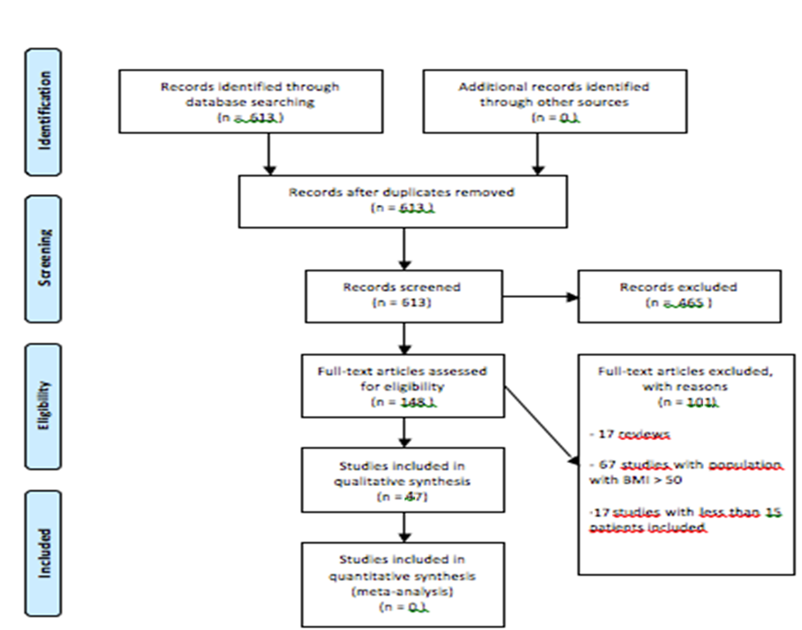
9- MBS and BMI>60
A total of 47 papers have been retrieved for qualitative analysis.
Twelve studies were focused on the safety and feasibility of MBS among patients with severe obesity at 30 days follow-up after surgery, and there was with no reported data on weight loss or obesity-related co-morbidities.
Thirty-five studies analyzed safety, feasibility, and medium to long-term results of MBS in patients with obesity and BMI ≥ 60 kg/m2.

Slide 44
9- MBS and BMI>60
Recommendation:
• MBS is safe and effective in patients with BMI ≥ 60 kg/m²
Grade of recommendation B
Level of Evidence 2A
Evidence suggests a higher rate of perioperative complications after MBS in patients with BMI ≥ 60 kg/m².
According to the literature, MBS appears safe in patients with initial BMI ≥ 70 kg/m²

Slide 45
10- MBS in patients with liver cirrhosis
A total of 47 papers have been retrieved for qualitative analysis.
Twelve studies were focused on the safety and feasibility of MBS among patients with severe obesity at 30 days follow-up after surgery, and there was with no reported data on weight loss or obesity-related co-morbidities.
Thirty-five studies analyzed safety, feasibility, and medium to long-term results of MBS in patients with obesity and BMI ≥ 60 kg/m2.

Slide 46
10- MBS in patients with liver cirrhosis
Recommendation:
• Obesity is a significant risk factor for MAFLD and liver cirrhosis.
Grade of recommendation B
Level of Evidence 2b
MBS has been associated with histologic improvement of MAFLD and regression of liver fibrosis
MBS is associated with a risk reduction of progression of MAFLD to liver cirrhosis.
MBS in patients with ‘decompensated’ cirrhosis is associated with high perioperative mortality.
Careful patient selection and consideration of the choice of surgical procedure are important to ensure the best outcomes.

Slide 47
11- MBS in patients with heart failure
Thirty-one full-text articles were assessed for eligibility.
studies are included in the qualitative synthesis.
MBS is associated with a lower risk of major adverse cardiovascular events (MACE) including myocardial infarction, ischemic heart disease or heart failure (HF) in patients with severe obesity

Slide 48
11- MBS in patients with heart failure
Recommendation:
Grade of recommendation B
Level of Evidence 2b
In patients with obesity and HF, MBS has low morbidity and mortality and can be a useful adjunct before heart transplantation or placement of LVAD.

Slide 49
12- Multidisciplinary care
The search screened 95 papers but only 6 were fully analyzed.
There were guidelines or consensus statements from the European Association for the Study of Obesity (EASO) and the European Association for Endoscopic Surgery (EAES)

Slide 50
12- Multidisciplinary care
Recommendation:
MDT has an important role in the pre and post operative management of MBS patients
Grade of recommendation B
Level of Evidence 2b

Slide 51
13- Revisional Surgery
Twenty-six studies were selected for this Systematic Review
All studies were retrospective with a good/fair quality.
Recent articles report conversion from AGB and SG and revision of RYGB and OAGB.

Slide 52
13- Revisional Surgery
Recommendation:
• Indication for revisional surgery after MBS varies among individual patients, but may include insufficient weight loss, weight regain, insufficient remission of co-morbidities, and management of complications [e.g. gastroesophageal reflux].
Grade of recommendation B
Level of Evidence 2b
Due to its complexity, revisional MBS may be associated with higher rates of perioperative complications.
However, revisional MBS induces satisfactory metabolic outcomes with acceptable rates of complications and mortality.

Slide 54
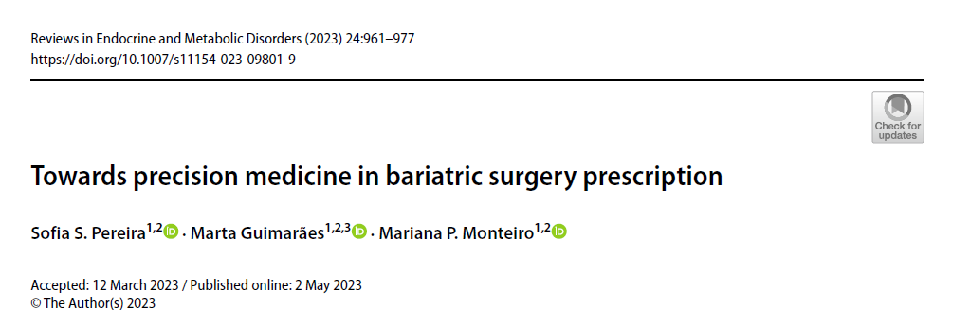

Slide 55
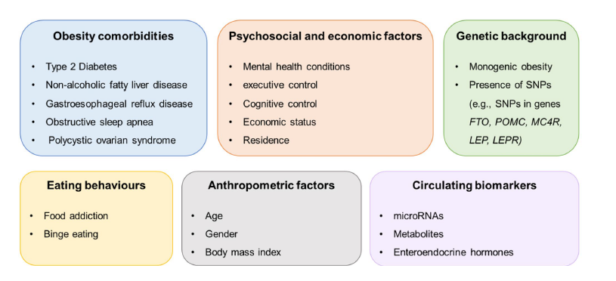
Despite there are universally accepted indications for considering bariatric surgery
there are no defined criteria for the use of each procedure nor guidelines for a patient-tailored decision among different technical procedures in order to optimize bariatric surgery outcomes.

Slide 56
Antonio Vitiello M.D. PhD FIFSO
Ricercatore in Chirurgia Generale
AOU Federico II di Napoli
Dirigente Medico- UOC Chirurgia Generale Oncologica e Mininvasiva - Direttore Prof. Vincenzo Pilone

